Slide 1

ExcelR Conversational AI
Analysis
Team - 4
Niranjan Sapkal
Nilay Ranade
Neha Goyal
Chetan Yewale
Rohan Gudekar
Mentors
Sri Vinod
Byom

Slide 2
In this era of Ai/DS, things are changing rapidly. Because of its horizontal nature, companies across the globe are adopting this technology in a quest for efficiency and optimization. One such rapidly changing sector is conversational AI because of its 3600 advantage such as:
24*7 Service
Easy Connectivity
Unbiased Conversation
Reduced Human Dependency
Effective Connectivity
With the above discussed benefits these data points are also full of insights. So as a Data Scientist in this project we are responsible for extracting all the actionable insights, helpful for business.
ABOUT
PROJECT

Slide 3
Business Objectives
BUSINESS
OBJECTIVES
Resource Allocation
Content Modification
Service Improvement
Above Objectives Can Be Accomplished By Performing
Exploratory Analysis on Structured Data
Topic Mining on Unstructured Data

Slide 4
OVERVIEW OF DATA SET
91 Days Conversational Data
File Format - Text Files (91)
Data is in Semi Structured Format
Including Conversation Transcripts Between Visitor and ExcelR Chatbot
Structured Data (14 Variables)
Visitor ID: 591061.v4ien5k0d36DSO
Visitor Name: Visitor 66013368
Visitor Email:
Visitor Notes:
IP: 106.51.240.188
Country Code: IN
Country Name: India
Region: Karnataka
City: Bengaluru
User Agent: Mozilla/5.0 (Linux; Android 9; Redmi Note 7S) AppleWebKit/537.36 (KHTML, like Gecko) Chrome/78.0.3904.62 Mobile Safari/537.36
Platform: Android
Browser: Chrome
Unstructured Data (chat between Visitor and bot)
(2019-11-02 07:37:58) Mounica Patel: Thank you for connecting with ExcelR! We don’t just train, we transform by making a POSITIVE impact on your CAREER!
Hello, how may I be of assistance to you?
(2019-11-02 07:40:06) Visitor 66013368: Hi
(2019-11-02 07:40:12) Mounica Patel: Hello, how may I be of assistance to you?
(2019-11-02 07:40:45) Visitor 66013368: Do you provide weekend batches
(2019-11-02 07:41:02) Mounica Patel: yes
(2019-11-02 07:41:19) Visitor 66013368: Is ur office is opened today?
(2019-11-02 07:41:32) Visitor 66013368: Btm 1stage
(2019-11-02 07:42:02) Mounica Patel: yes

Slide 5
ACTIONABLES:
1.Parser
2. Exploratory Data Analysis
3.Topic Mining
4. Actionable Insights Extraction Inline with the Objectives
5. Project Submission

Slide 6
Data Parsing

Slide 7
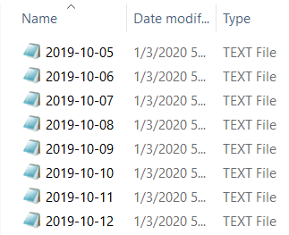
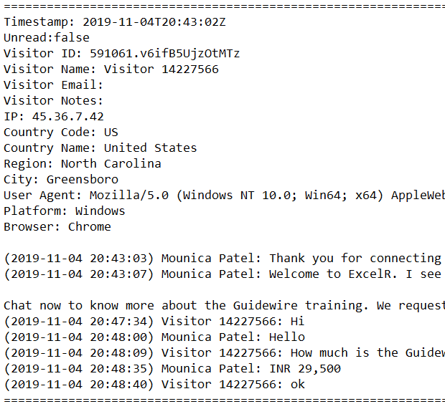
Before Data Parsing
Data Set (91 text files)
Data Content (each file content)
There are all out 91 .txt document each record contain every day customer data and their conversation among visitor and ExcelR Chatbot
Since the information is in semi-structured format, we have to parsed the information for extracting all the significant bits of knowledge

Slide 8
After Data Parsing
Structured Data (Sample)
14 Variables
127825 Observation
Timestamp | Unread | Visitor ID | Visitor Name | Visitor Email | Visitor Notes | IP
2019-10-05T23 | FALSE | 591061.uEiWsUtI89Aqxd | Visitor 96514674 |  |  | 157.48.92.207
2019-10-05T23 | FALSE | 591061.uciadQYxuoSOeO | Visitor 22640782 |  |  | 66.102.8.198
2019-10-05T23 | FALSE | 591061.uciadQEeGT0Ukz | Visitor 2487023 |  |  | 202.187.41.83
2019-10-05T23 | FALSE | 591061.uciadPhvt7PWns | Visitor 46315534 |  |  | 113.210.67.4
2019-10-05T23 | FALSE | 591061.uciadOX4ZEKcw2 | Visitor 16365081 |  |  | 66.102.8.203
Country Code | Country Name | Region | City | User Agent | Platform | Browser
IN | India | Telangana | Hyderabad | Mozilla/5.0 (Linux; Android 8.1.0; Redmi Note 6 Pro) AppleWebKit/537.36 (KHTML, like Gecko) Chrome/75.0.3770.143 Mobile Safari/537.36 | Android | Chrome
US | United States |  |  | Mozilla/5.0 (X11; Linux x86_64) AppleWebKit/537.36 (KHTML, like Gecko; Google Page Speed Insights) Chrome/41.0.2272.118 Safari/537.36 | Linux | Chrome
MY | Malaysia | Kuala Lumpur | Kuala Lumpur | Mozilla/5.0 (Windows NT 10.0; Win64; x64) AppleWebKit/537.36 (KHTML, like Gecko) Chrome/77.0.3865.90 Safari/537.36 | Windows | Chrome
MY | Malaysia | Kuala Lumpur | Kuala Lumpur | Mozilla/5.0 (Linux; Android 6.0.1; SAMSUNG SM-N910C Build/MMB29K) AppleWebKit/537.36 (KHTML, like Gecko) SamsungBrowser/9.2 Chrome/67.0.3396.87 Mobile Safari/537.36 | Android | Chrome
US | United States |  |  | Mozilla/5.0 (X11; Linux x86_64) AppleWebKit/537.36 (KHTML, like Gecko; Google Page Speed Insights) Chrome/41.0.2272.118 Safari/537.36 | Linux | Chrome

Slide 9
Continued…
Unstructured Data (Sample)
Conversations between Visitors and Bot
(2019-10-05 23:59:46) Mounica Patel: Thank you for connecting with ExcelR! We donâ€™t just train, we transform by making a POSITIVE impact on your CAREER!
(2019-10-05 23:59:50) Mounica Patel: I see that you are exploring about PMP Course training. ExcelR is a globally accredited institute to deliver PMP training, from PMI (PMI REP ID : 4635). Faculty is our forte. Top Notch facutly with over 20 years experience. Crack PMP at first attempt with our PMP PREP Plan ! We hold an record of 96.3% PMP passrate.
35 PDUs, Life Time E-Learning Access, WhatsApp Support ,AND with this you will Get free MSPROJECT & PRIMAVERA E-learning Videos.
Exclusive October Month Offer :-
Love To Save Money!!! Enroll & GET 10% Special Discount on PMP Course
For this we request you to provide us your Name,Contact number, Email id & Location. So, you will get a quick information about the training
================================================================================
(2019-10-05 23:55:37) Mounica Patel: Thank you for connecting with ExcelR! We donâ€™t just train, we transform by making a POSITIVE impact on your CAREER!
================================================================================
(2019-10-05 23:55:04) Mounica Patel: Thank you for connecting with ExcelR! We donâ€™t just train, we transform by making a POSITIVE impact on your CAREER!
================================================================================
This unstructured data conversation among visitor and ExcelR Chatbot which can be used for topic mining

Slide 10
Exploratory Data Analysis- Structured Data

Slide 11
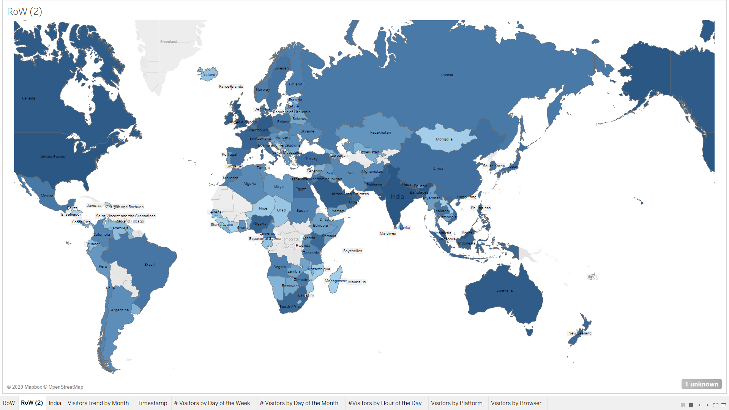
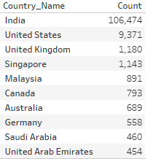
Global Visitors of ExcelR Solutions (Heat Map)
Top 10 Countries by # Visitors
1
Global Visitors
2
India Visitors
3
RoW Visitors

Slide 12
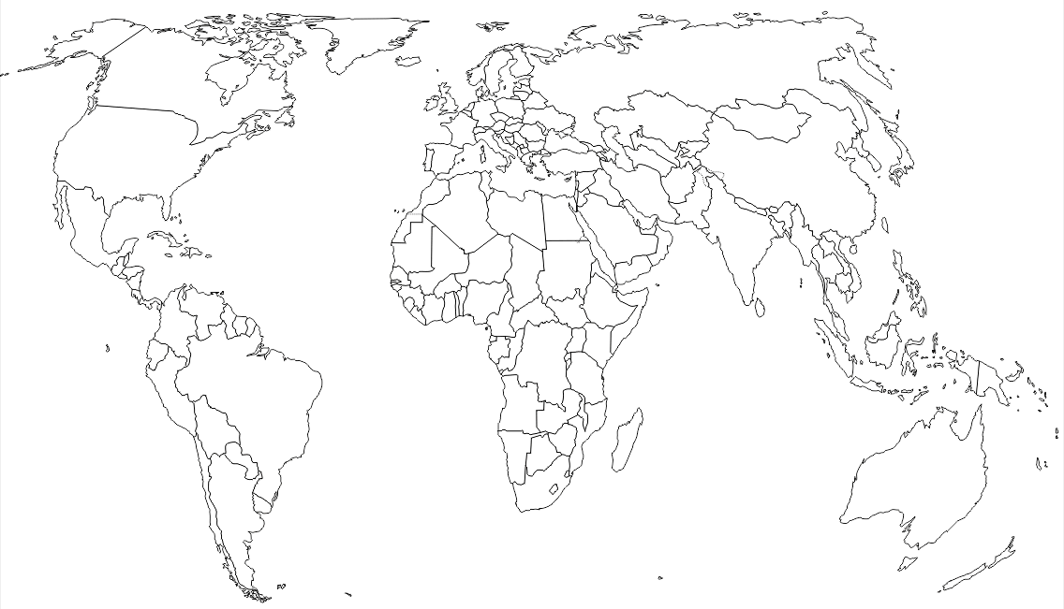
Global ExcelR Conversational AI Analysis

Slide 13
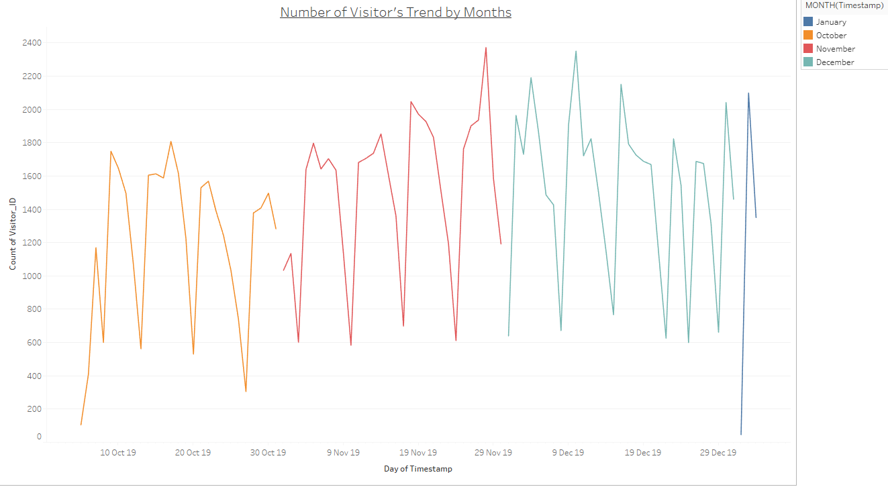

Timestamp
Global Monthly Visitors Trend
Positive Trend
Over the period of time (5th Oct 2019 to 3rd Jan 2020) number of visitors has increased; demonstrating positive trend

Slide 14
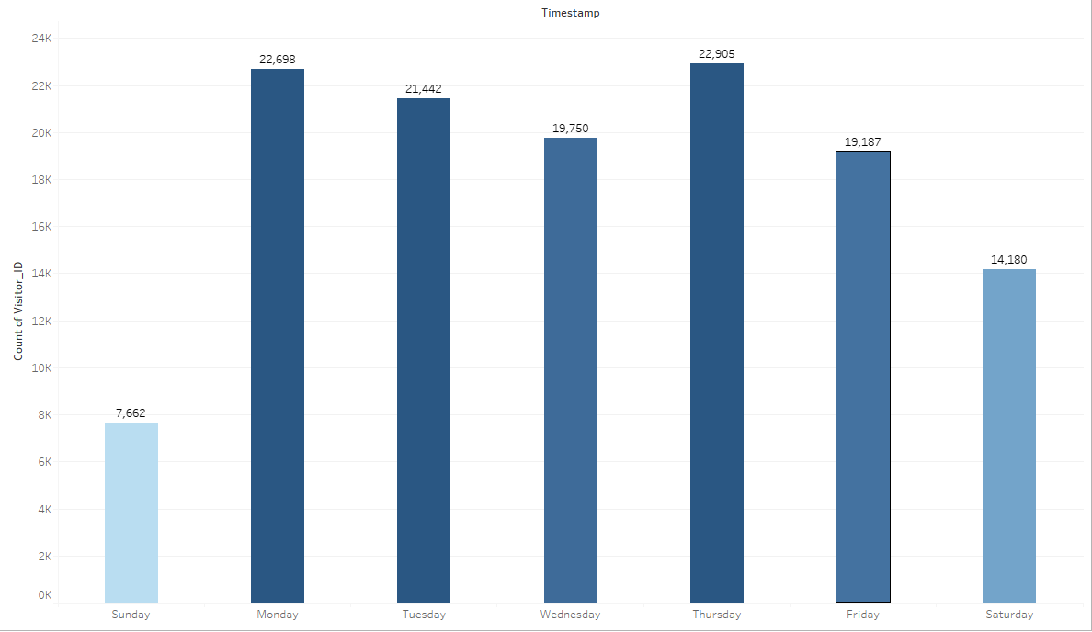
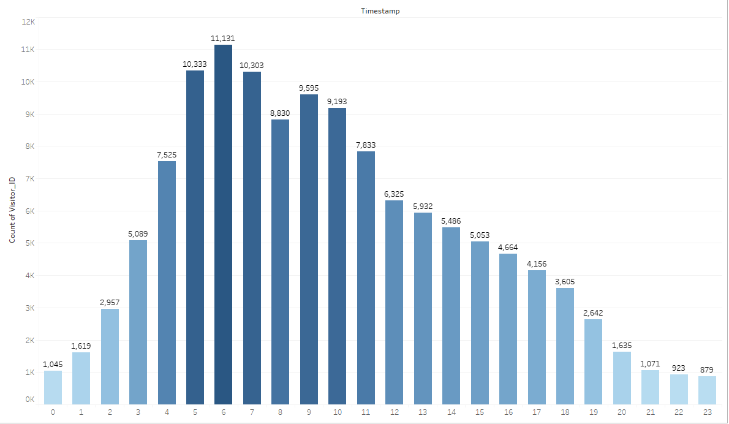
Continued…
Day of the Week Analysis
Hourly Data Analysis
Start of the week (Mon, Tue) and before start of the weekend there is surge in number of visitors
Day of the week graph shows that weekends (Sat, Sun) has less number of visitors compared to weekdays
Investigation on hourly data indicates that the majority of the visitors are active from UTC 4 AM to UTC 12 PM
(IST 9:30 AM to IST 5:30 PM)

Slide 15
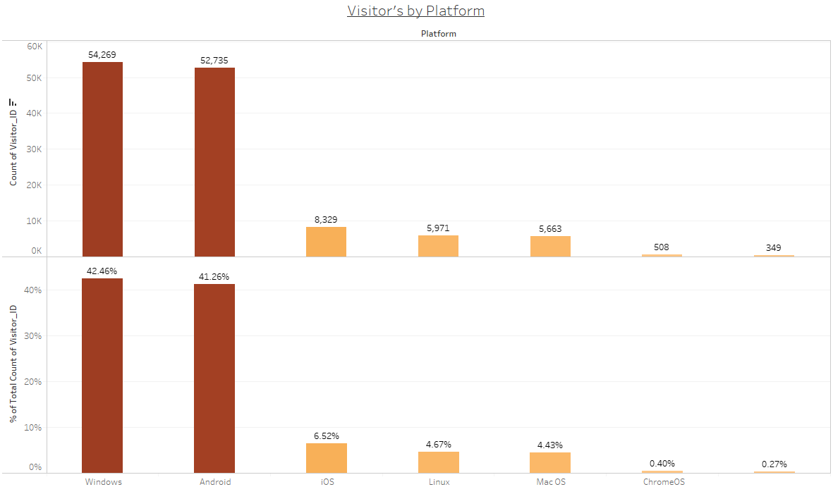
Platform
Platform Analysis
In the given time frame Windows and Android platform visitors held the largest share with 42.46% and 41.26% respectively
Other platforms such as iOS, Linux and Mac OS held comparatively very lower share ranging from 4.4% to 6.6%
It is highly recommended that ExcelR Solution’s Conversational AI should be smoothly integrated with Windows and Android platforms

Slide 16
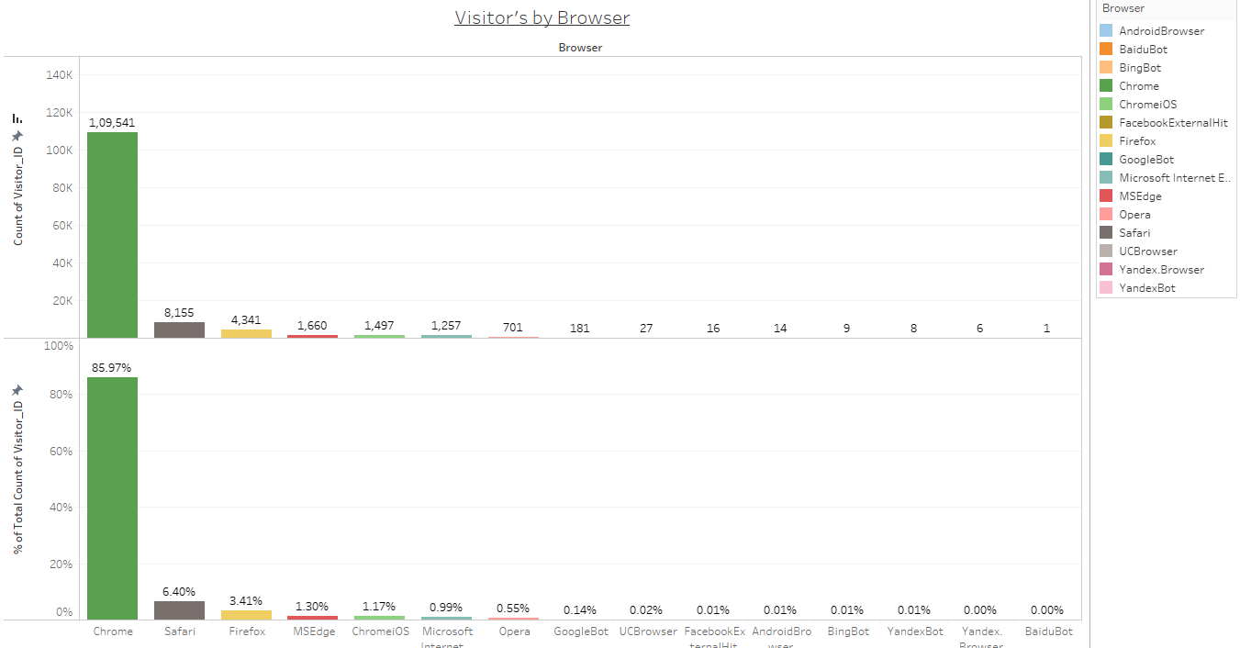
Browser
Browser Analysis
In the given time frame Chrome browser visitors held the largest share with more than 85%
Other platforms such as Safari, FireFox, MSEdge among others held comparatively very lower share ranging upto 6.5%
UI/UX design ExcelR Solution’s Conversational AI should be very user friendly for Chrome browser

Slide 17
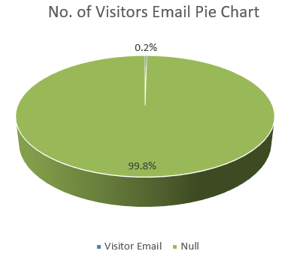
Visitors Email
Email ID Analysis
There were complete 860 email address we have out of which 298 email address were distinct and rest were copies
Repeated Email IDs (Sample)
Sr. No. | Visitor’s Email ID | Counts of Entries
1 | sandeepkavuri@gmail.com | 67
2 | atul_0012@yahoo.co.in | 37
3 | yssk143@gmail.com | 19
4 | vivekkumargupta.69@gmail.com | 19
5 | ramlotus@gmail.com | 17
Analysis on emails indicates that only 0.2% of visitor had shared their email address
ExcelR Solutions should mark email id as mandatory field to fill for visitors. It will help for marketing and promotion

Slide 18
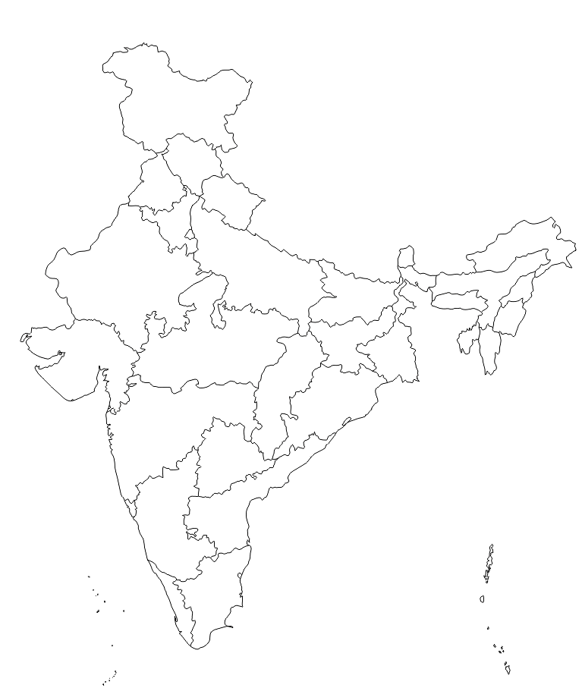
India ExcelR Conversational AI Analysis

Slide 19
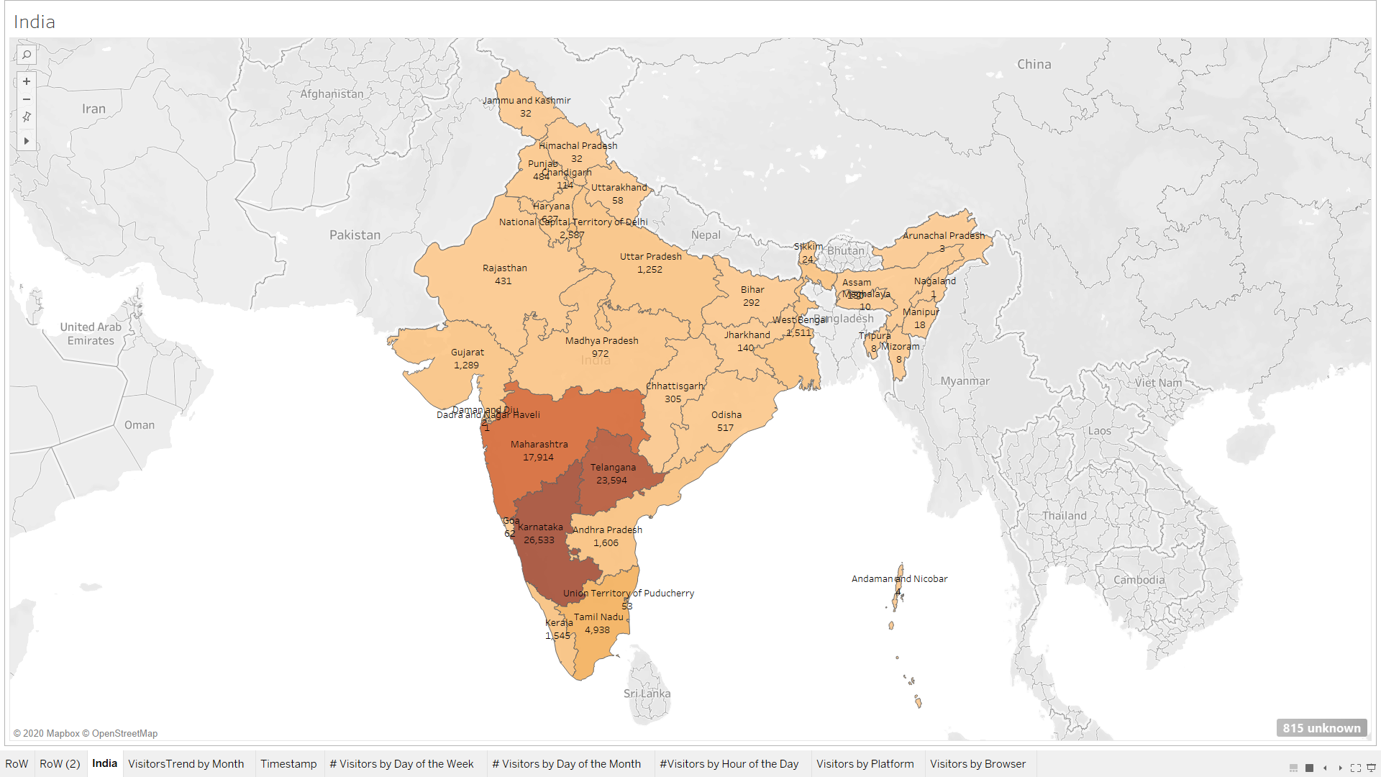
India Visitors of ExcelR Solutions
Top 10 States by Number of Visitors
Sr. No. | Region | Number of Visitors
1 | Karnataka | 31,401
2 | Telangana | 28,086
3 | Maharashtra | 21,179
4 | Tamil Nadu | 5,875
5 | National Capital Territory of Delhi | 3,065
6 | Andhra Pradesh | 1,932
7 | Kerala | 1,867
8 | West Bengal | 1,740
9 | Gujarat | 1,489
10 | Uttar Pradesh | 1,465
Number of Visitors by State in India

Slide 20
Top Cities in India
Top 20 Cities by Number of Visitors
Sr. No. | City | State | Number of Visitors | % of Total
1 | Bengaluru | Karnataka | 30,192 | 32.98%
2 | Hyderabad | Telangana | 26,553 | 29.01%
3 | Pune | Maharashtra | 10,580 | 11.56%
4 | Mumbai | Maharashtra | 8,857 | 9.68%
5 | Chennai | Tamil Nadu | 4,015 | 4.39%
6 | New Delhi | National Capital Territory of Delhi | 1,724 | 1.88%
7 | Kolkata | West Bengal | 1,536 | 1.68%
8 | Delhi | National Capital Territory of Delhi | 1,334 | 1.46%
9 | Coimbatore | Tamil Nadu | 1,081 | 1.18%
10 | Ahmedabad | Gujarat | 838 | 0.92%
11 | Noida | Uttar Pradesh | 575 | 0.63%
12 | Vijayawada | Andhra Pradesh | 526 | 0.57%
13 | Ernakulam | Kerala | 520 | 0.57%
14 | Gurgaon | Haryana | 505 | 0.55%
15 | Bhubaneswar | Odisha | 498 | 0.54%
16 | Indore | Madhya Pradesh | 489 | 0.53%
17 | Visakhapatnam | Andhra Pradesh | 477 | 0.52%
18 | Thane | Maharashtra | 435 | 0.48%
19 | Lucknow | Uttar Pradesh | 413 | 0.45%
20 | Secunderabad | Telangana | 391 | 0.43%
Top 5 cities in India (Bengaluru, Hyderabad, Pune, Mumbai and Chennai) collectively contribute more than 75% of the total visitors during the given timeframe
ExcelR Solutions should have physical presence if possible multiple offices/training classes in these cities as al the top 5 cities are tier 1 cities in India

Slide 21
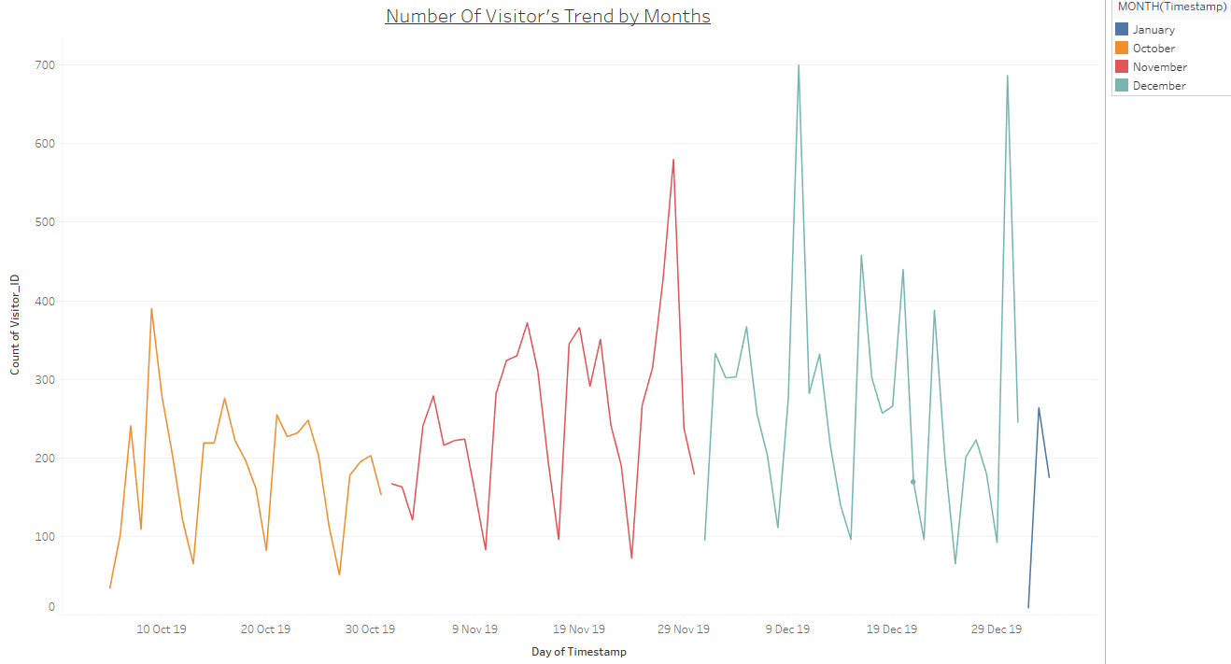
Timestamp (India)
India Monthly Visitors Trend
Strong Positive Trend
Over the period of time (5th Oct 2019 to 3rd Jan 2020) number of visitors has increased and demonstrating positive trend

Slide 22
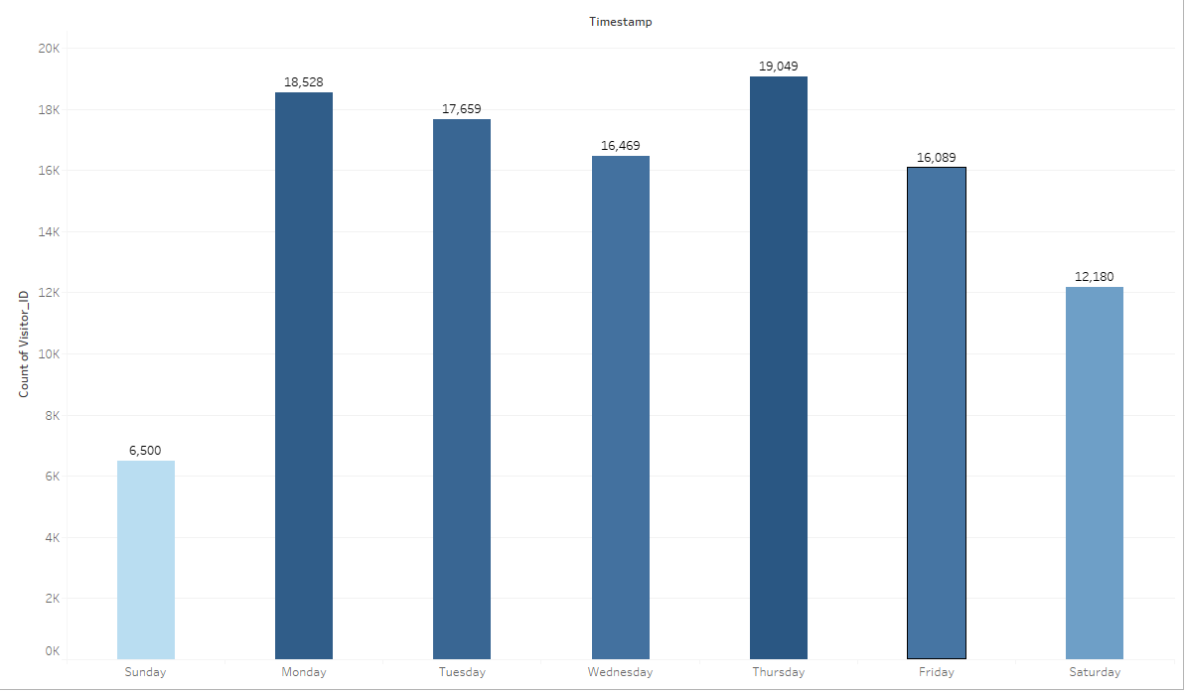
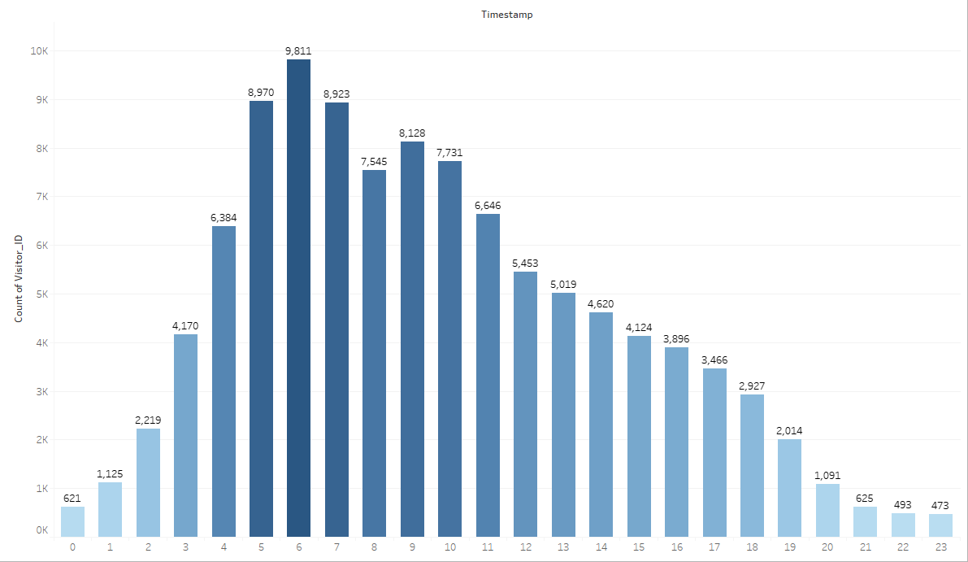
Continued…
Day of the Week Analysis
Hourly Data Analysis
Start of the week (Mon, Tue) and before start of the weekend there is surge in number of visitors
Day of the week graph shows that weekends (Sat, Sun) has less number of visitors compared to weekdays
Investigation on hourly data indicates that the majority of the visitors are active from UTC 4 AM to UTC 12 PM
(IST 9:30 AM to IST 5:30 PM)

Slide 23
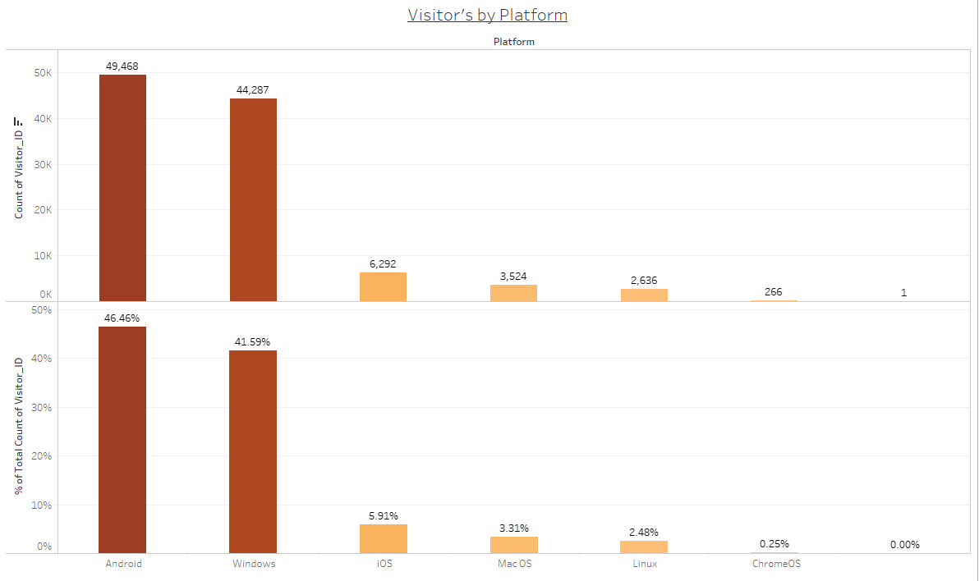
Platform
Platform Analysis
In the given time frame Android and Windows platform visitors held the largest share with 46.46% and 41.59% respectively
Other platforms such as iOS, Linux and Mac OS held comparatively very lower share ranging from 2.2% to 5.9%
It is highly recommended that ExcelR Solution’s Conversational AI should be smoothly integrated with Windows and Android platforms

Slide 24
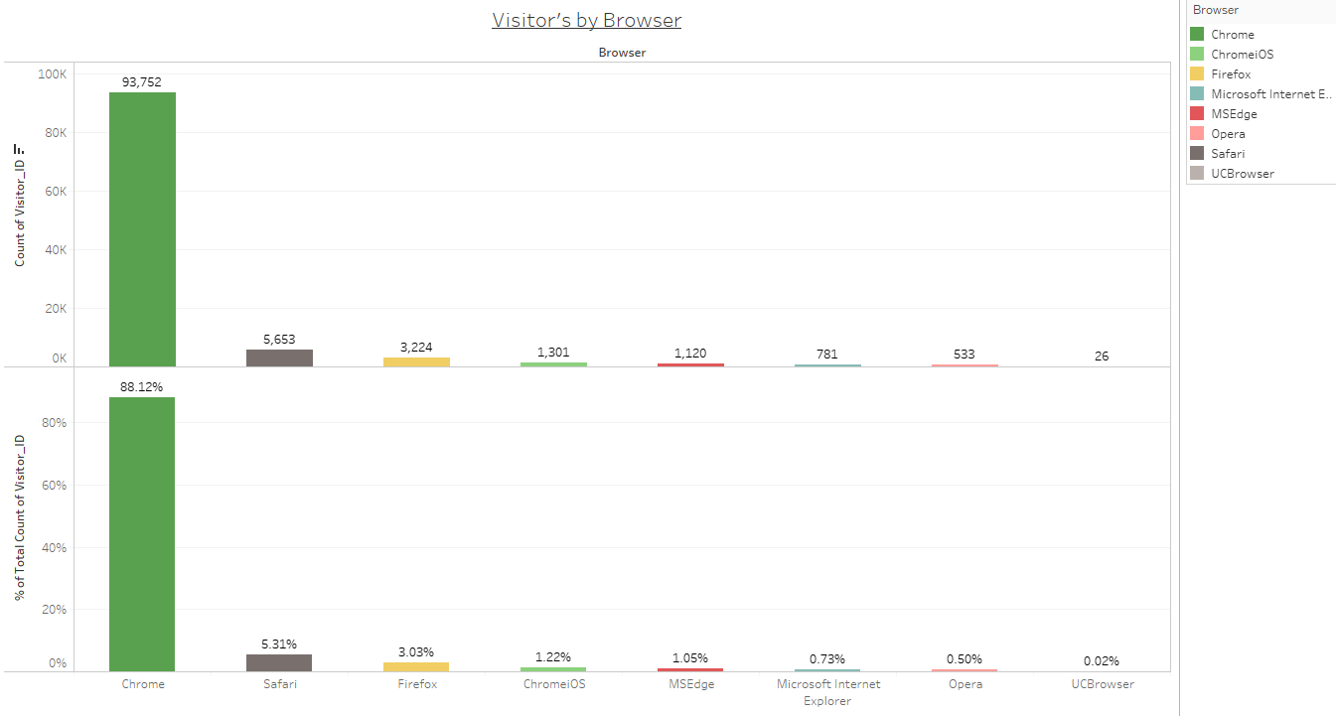
Browser
Browser Analysis
In the given time frame Chrome browser visitors held the largest share with more than 88.12%
Other platforms such as Safari, FireFox, MSEdge among others held comparatively very lower share ranging upto 5.3%
UI/UX design ExcelR Solution’s Conversational AI should be very user friendly for Chrome browser

Slide 25
Rest of World ExcelR Conversational AI Analysis

Slide 26
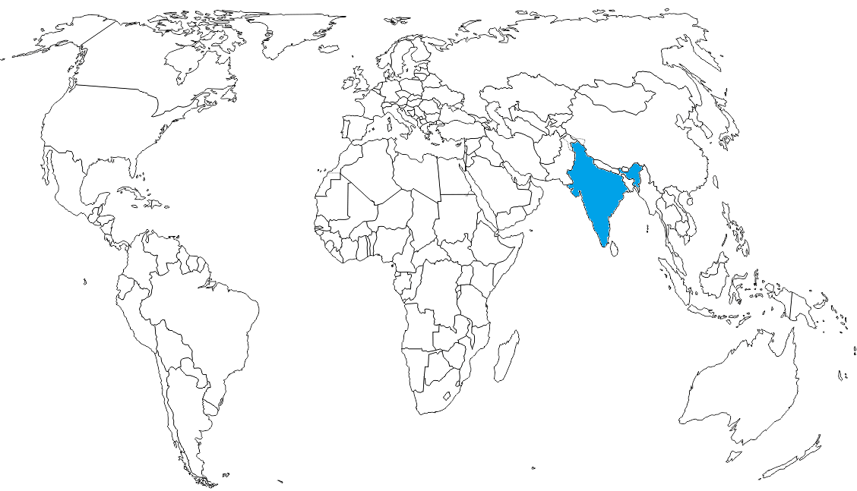
Rest of World ExcelR Conversational AI Analysis
Except India

Slide 27
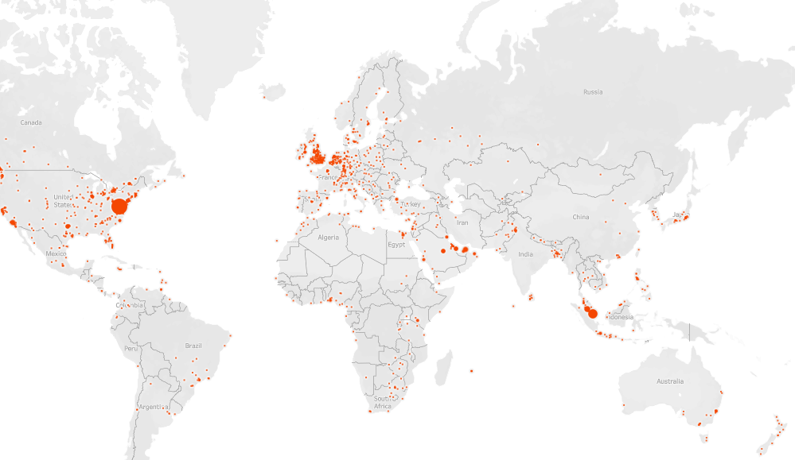
Visitor's From Rest of World
Top 20 Visitor's From Rest of World
Sr. No. | Region | Country Name | Number of Visitors
1 | Virginia | United States | 2621
2 | California | United States | 926
3 | Texas | United States | 850
4 | Kuala Lumpur | Malaysia | 415
5 | Ontario | Canada | 447
6 | Illinois | United States | 298
7 | Selangor | Malaysia | 317
8 | New Jersey | United States | 289
9 | New South Wales | Australia | 289
10 | New York | United States | 239
11 | Dubai | United Arab Emirates | 268
12 | North Carolina | United States | 211
13 | Georgia | United States | 191
14 | Ar Riyāḑ | Saudi Arabia | 190
15 | Victoria | Australia | 193
16 | Baladiyat ad Dawhah | Qatar | 219
17 | Ohio | United States | 222
18 | Punjab | Pakistan | 178
19 | Virginia | United States | 2621
20 | California | United States | 926
Number of Visitors by Rest of World

Slide 28
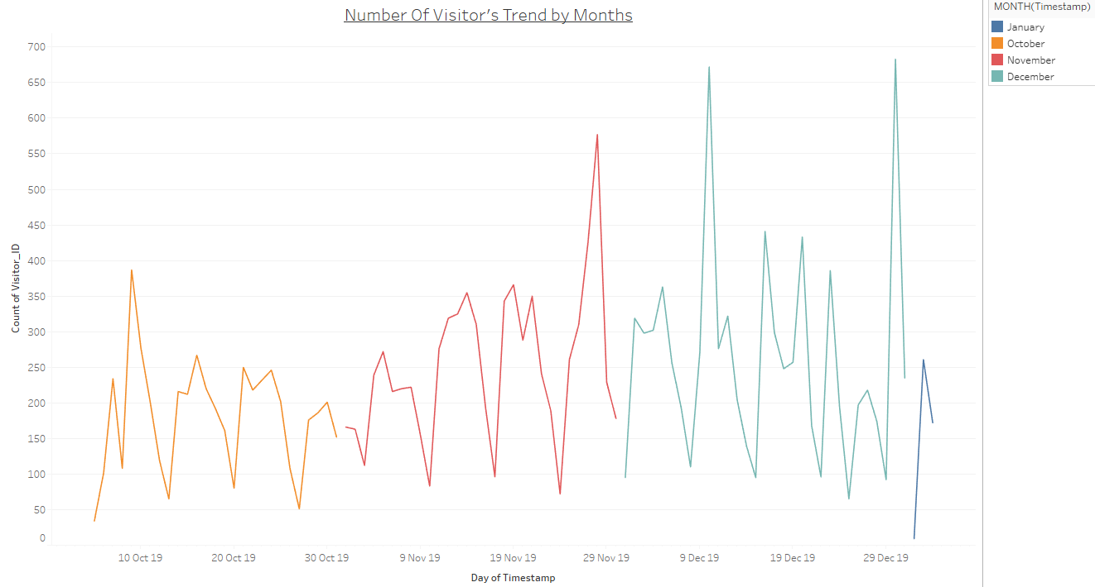
Timestamp
Monthly Data Analysis
Less Positive Trend
Over the period of time (5th Oct 2019 to 3rd Jan 2020) number of visitors has marginally increased as compared to Indian visitors

Slide 29
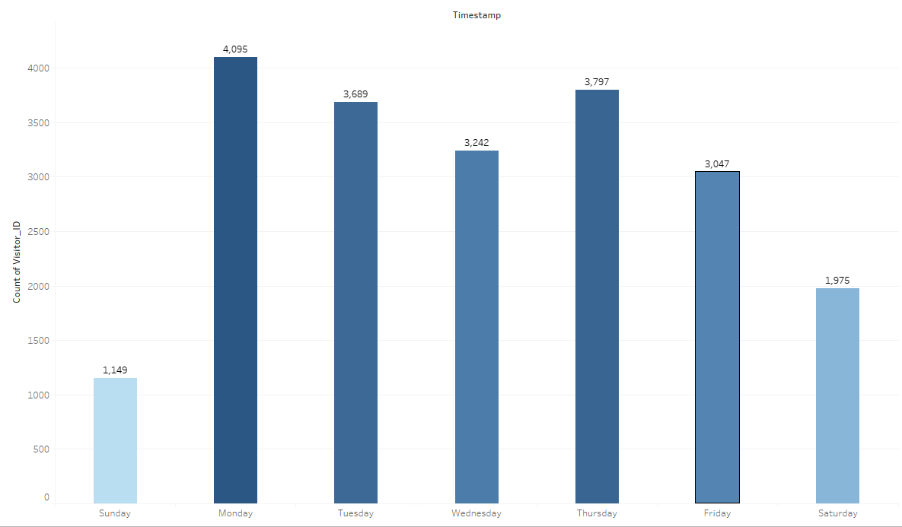
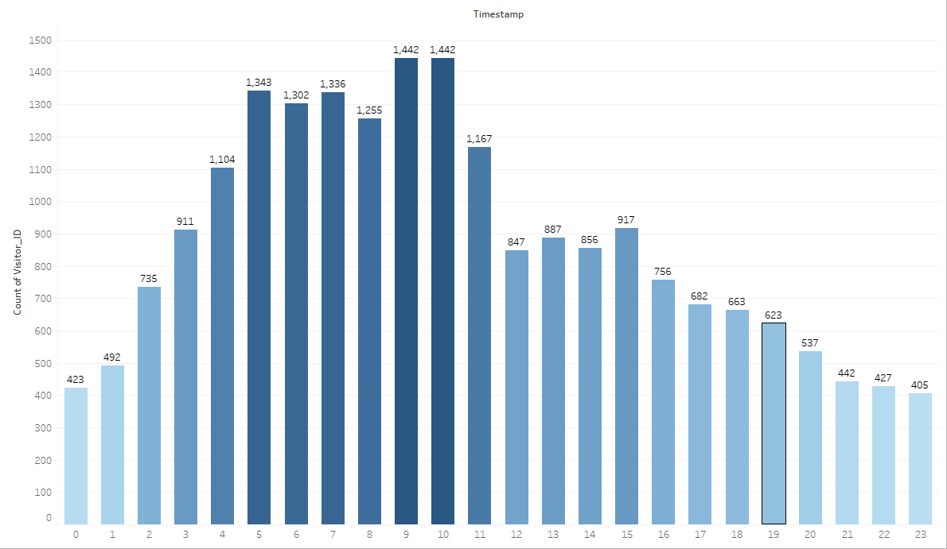
Continued…
Day of the Week Analysis
Hourly Data Analysis
Start of the week (Mon, Tue) and before start of the weekend there is surge in number of visitors
Day of the week graph shows that weekends (Sat, Sun) has less number of visitors compared to weekdays
Investigation on hourly data indicates that the majority of the visitors are active from UTC 5 AM to UTC 11 PM
(IST 10:30 AM to IST 4:30 PM)

Slide 30
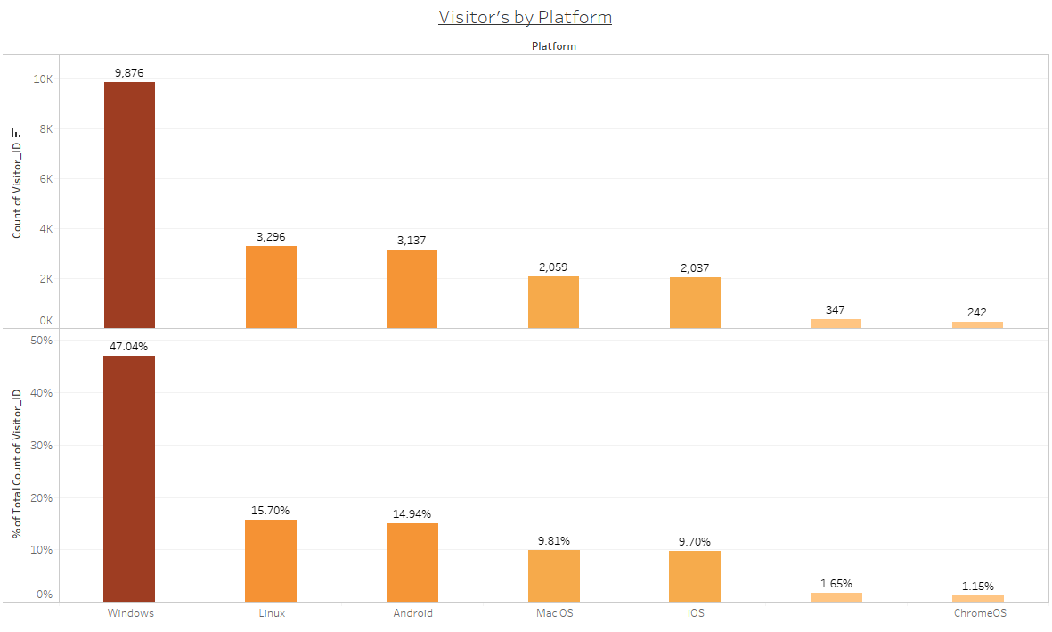
Platform
Platform Analysis
In the given time frame Windows and Linux platform visitors held the largest share with 47.04% and 15.70% respectively
Other platforms such as Android, Mac OS, iOS held comparatively very lower share ranging from 9.96% to 1.16%
It is highly recommended that ExcelR Solution’s Conversational AI should be smoothly integrated with Windows and Android platforms

Slide 31
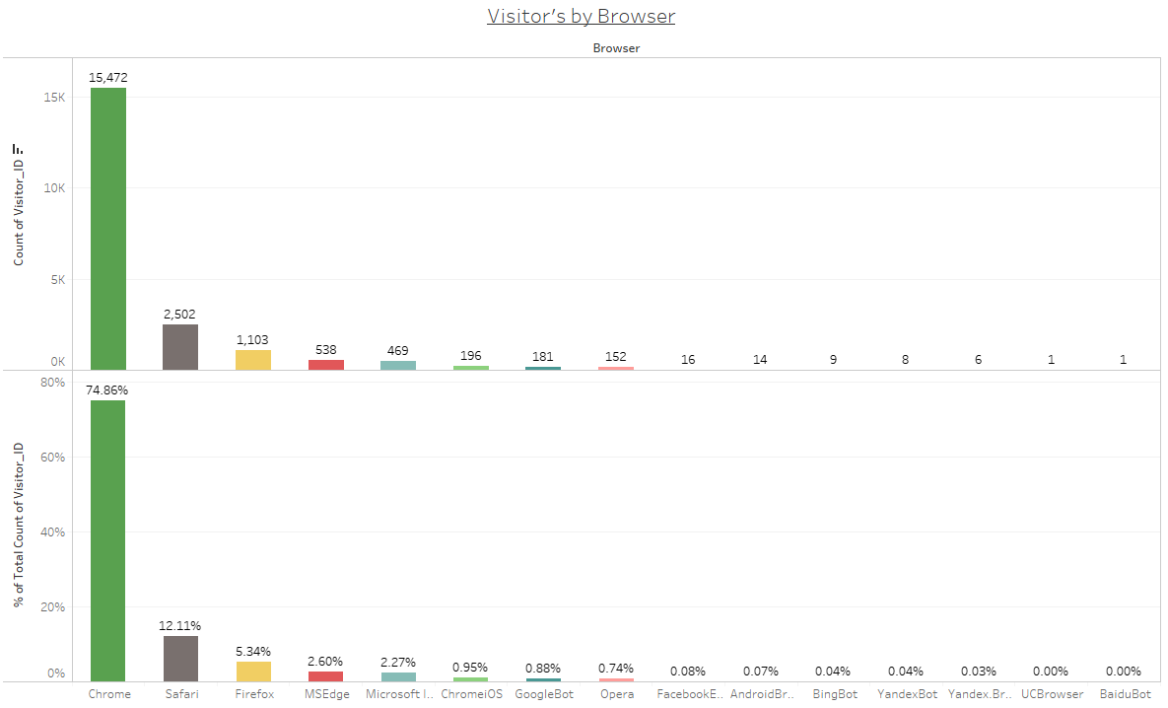
Browser
Browser Analysis
In the given time frame Chrome browser visitors held the largest share with more than 74.86%
Other platforms such as Safari, FireFox, MSEdge among others held comparatively very lower share ranging upto 12.11%
UI/UX design ExcelR Solution’s Conversational AI should be very user friendly for Chrome browser

Slide 32
Topic Modelling On Unstructured Data

Slide 33
CLASSIFICATION OF CONVERSATION
Overall Conversation
Visitor Conversation
Bot Conversation

Slide 34
Topic Mining on Visitor Conversation

Slide 35
Extraction from Visitors Chat
Visitors Chat
Data-Cleaning
(2019-10-05 23:26:21) Visitor 82253928: Hi
(2019-10-05 23:26:49) Visitor 82253928: How many day the course
(2019-10-05 23:27:22) Visitor 82253928: hu
(2019-10-05 20:06:03) Visitor 63953983: Visitor uploaded: IMG-20180113-WA0012.jpg
(2019-10-05 18:47:00) Visitor 22845060: what other training do u offer ?
(2019-10-06 11:16:15) Visitor 6631757: Can you please send contact number and location
(2019-10-06 11:16:46) Visitor 6631757: Regarding Service now course
(2019-10-06 11:16:59) Visitor 6631757: Fee details and duration
(2019-10-06 11:17:29) Visitor 6631757: Location please
(2019-10-06 11:12:01) Visitor 6631757: Hi
(2019-10-06 11:12:29) Visitor 6631757: Service now
(2019-10-06 11:13:07) Visitor 6631757: Location please
(2019-10-06 11:13:37) Visitor 6631757: One of my friend looking for that
(2019-10-06 11:14:22) Visitor 6631757: phone number
(2019-10-06 10:56:30) Visitor 98520502: Hey i was looking for the business analytics course
(2019-10-06 10:56:43) Visitor 98520502: Cud u plz help me wid the course details
(2019-10-06 10:58:26) Visitor 98520502: Same fee for classroom and online training?
RemoveEmail
Tolower
removePunctuation
removeWords
removeNumbers
stripWhitespace
wordLengths of 3 to 15

Slide 36
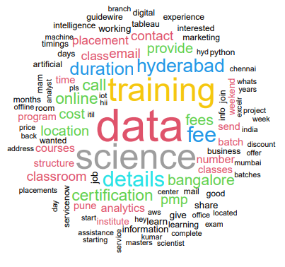
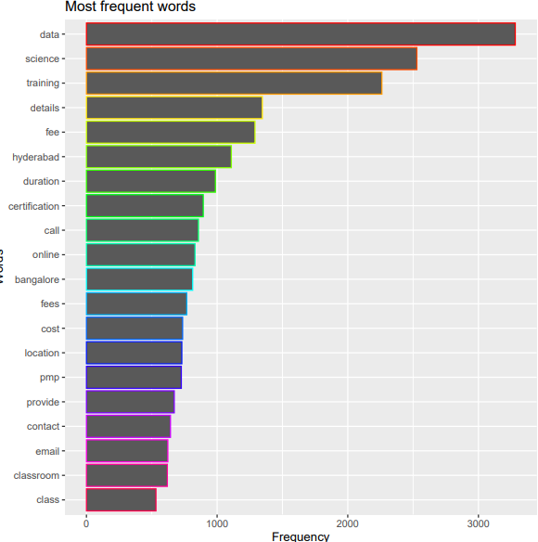
Term Document Matrix
Wordcloud
Barplot

Slide 37
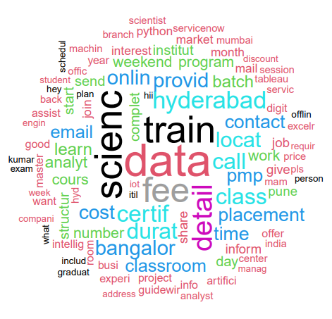
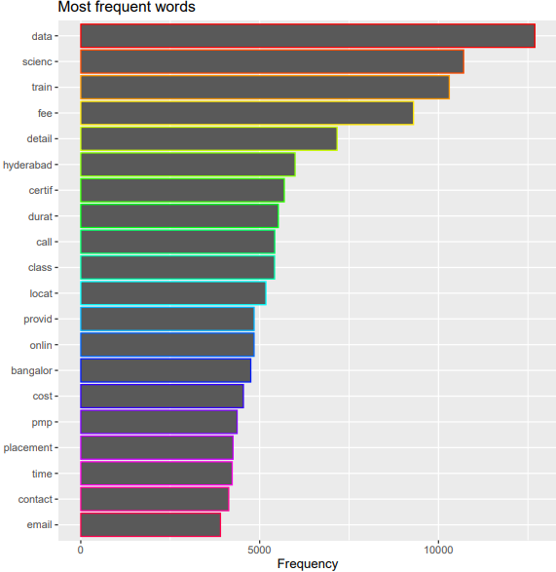
TF - Inverse Document Frequency
Wordcloud
Barplot

Slide 38

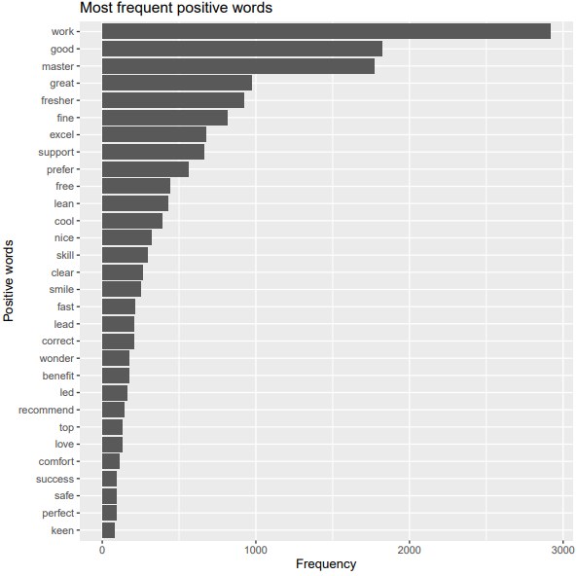
Term Document Matrix Positive Words
Wordcloud
Barplot

Slide 39

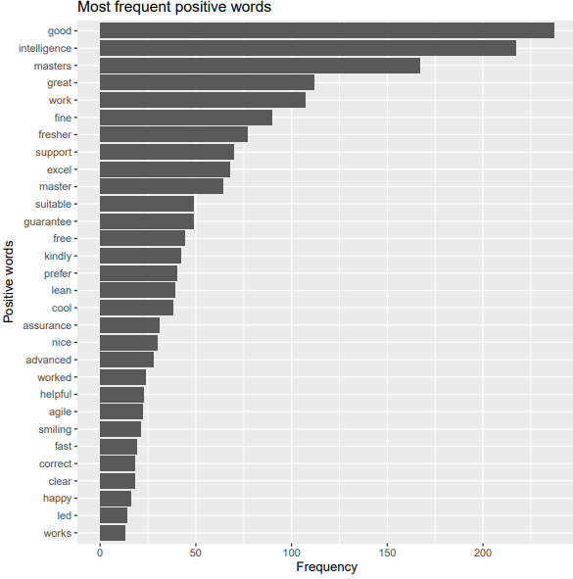
TF-Inverse Document Frequency Positive Words
Wordcloud
Barplot

Slide 40
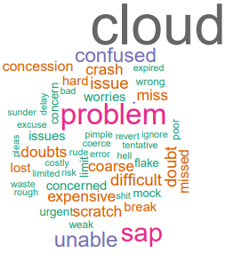
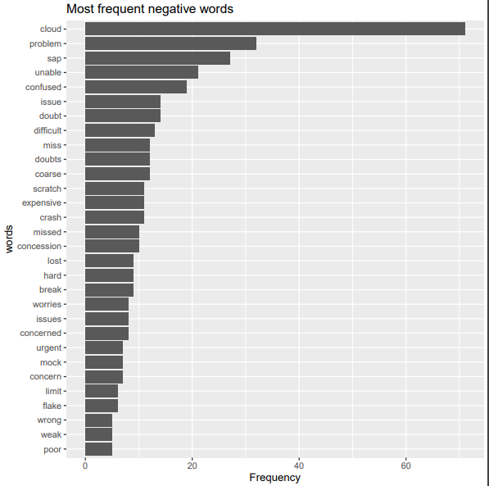
Term Document Matrix Negative Words
Wordcloud
Barplot

Slide 41
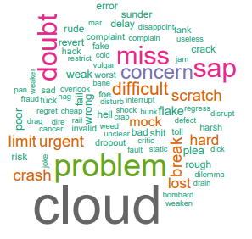
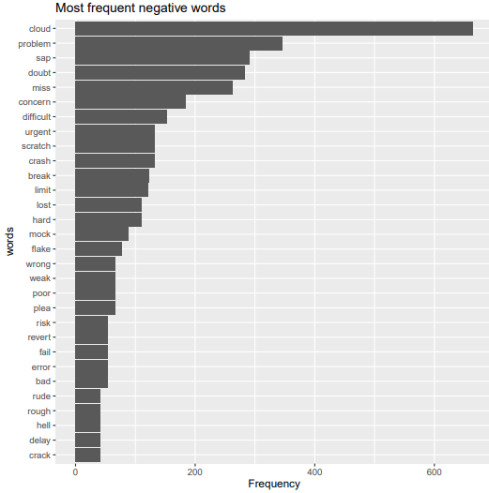
TF-Inverse Document Frequency Negative Words
Wordcloud
Barplot

Slide 42

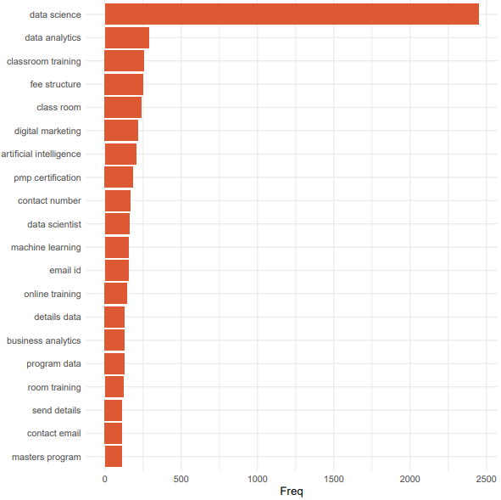
Bigram Visualization
Wordcoud
Barplot

Slide 43
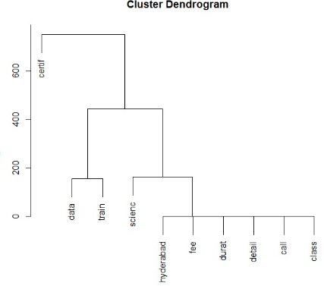
Complete Linkage

Slide 44
BOT CONVERSATION
BOT Chat
Data-Cleaning
(2019-10-05 23:59:46) Mounica Patel: Thank you for connecting with ExcelR! We don<e2><80><99>t just train, we transform by making a POSITIVE impact on your CAREER!
(2019-10-05 23:59:50) Mounica Patel: I see that you are exploring about PMP Course training. ExcelR is a globally accredited institute to deliver PMP training, from PMI (PMI REP ID : 4635). Faculty is our forte. Top Notch facutly with over 20 years experience. Crack PMP at first attempt with our PMP PREP Plan ! We hold an record of 96.3% PMP passrate.
35 PDUs, Life Time E-Learning Access, WhatsApp Support ,AND with this you will Get free MSPROJECT & PRIMAVERA E-learning Videos.
Love To Save Money!!! Enroll & GET 10% Special Discount on PMP Course
" For this we request you to provide us your Name,Contact number, Email id & Location. So, you will get a quick information about the training "
(2019-10-05 23:47:07) Mounica Patel: I see that you are exploring about PMP Course training. ExcelR is a globally accredited institute to deliver PMP training, from PMI (PMI REP ID : 4635). Faculty is our forte. Top Notch facutly with over 20 years experience. Crack PMP at first attempt with our PMP PREP Plan ! We hold an record of 96.3% PMP passrate.
RemoveEmail
Tolower
removePunctuation
removeWords
removeNumbers
stripWhitespace
wordLengths of 3 to 15

Slide 45

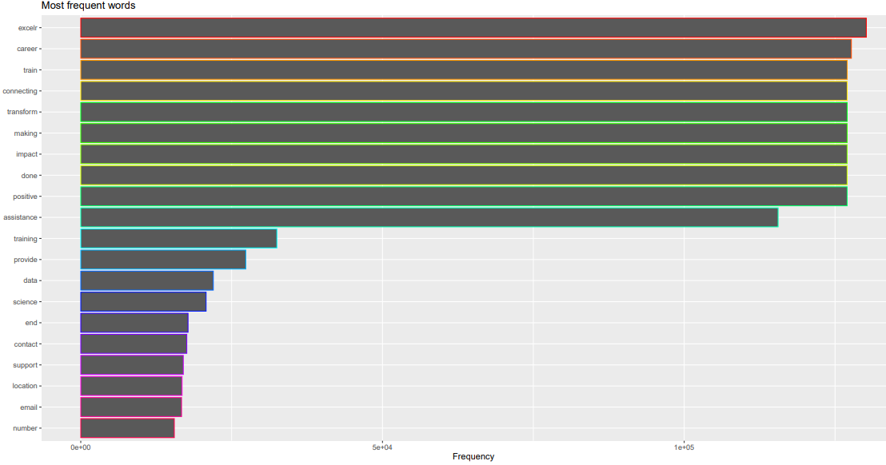
Term Document Matrix
Wordcloud
Barplot

Slide 46

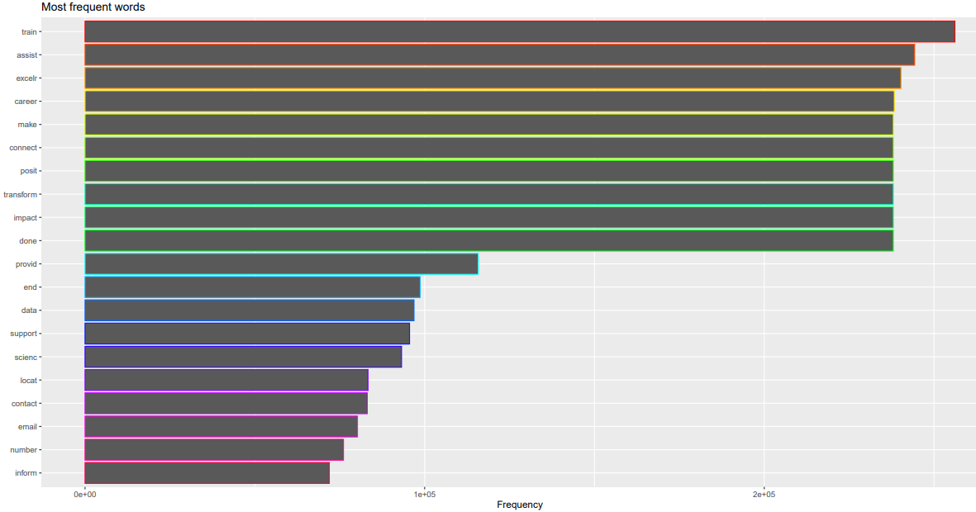
TF-Inverse Document Frequency
Wordcloud
Barplot

Slide 47

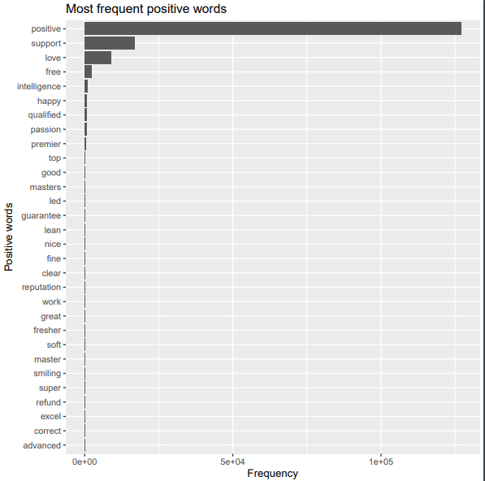
Term Document Matrix Positive Words
Wordcloud
Barplot

Slide 48
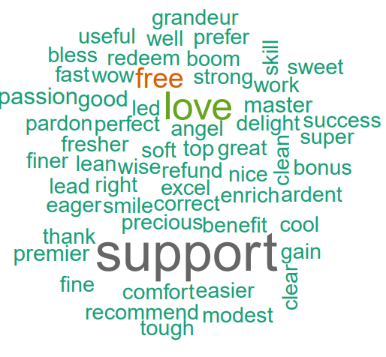
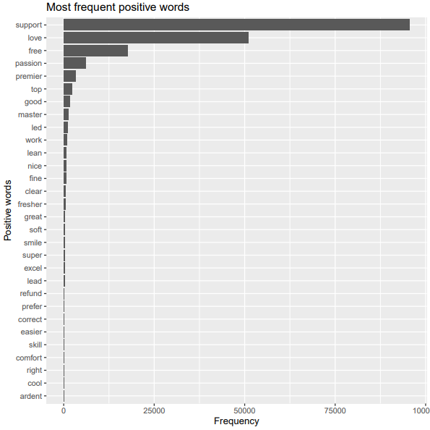
TF-Inverse Document Frequency Positive Words
Wordcloud
Barplot

Slide 49
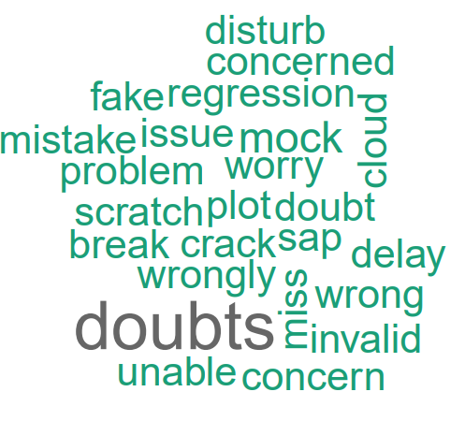
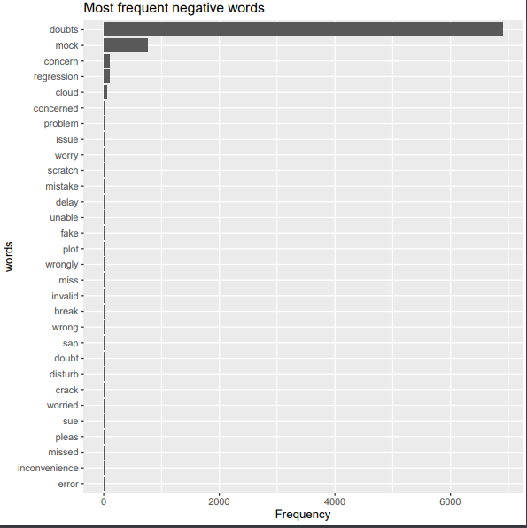
Term Document Matrix Negative Words
Wordcloud
Barplot

Slide 50
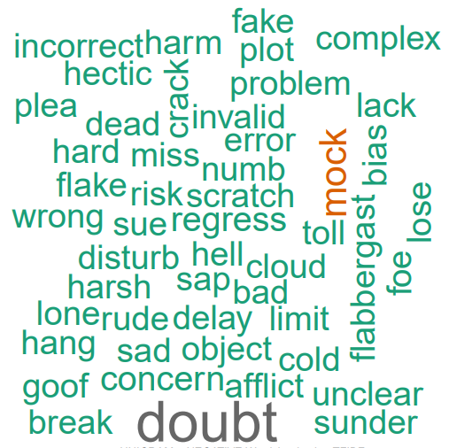
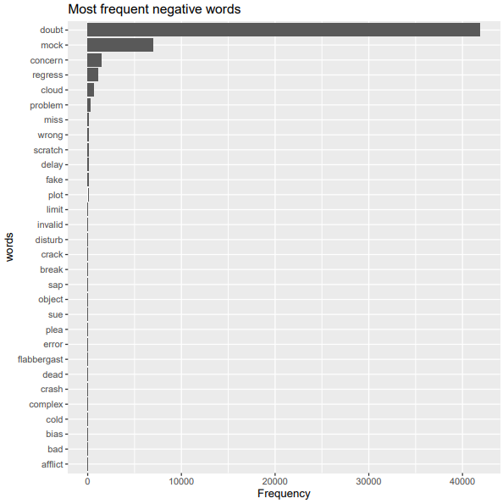
TF-Inverse Document Frequency Negative Words
Wordcloud
Barplot

Slide 51

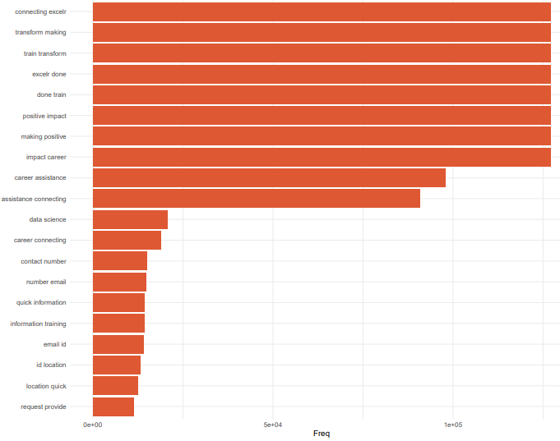
Bigram Visualization
Wordcloud
Barplot

Slide 52
Actionable Insights
Resource Allocation
More resource should be allocated within the timespan of UTC 4 AM to UTC 12 PM
Content Modification
Submission Of Email Id should be mandatory For each Visitor's, So we can also provide Information through EMail Id.
UI/UX design ExcelR Solution’s Conversational AI should be very user friendly for Chrome browser.
Service Improvement
Maintenance of Chatbots should be avoided during time period UTC 4 AM to UTC 12 PM

Slide 53
Further Steps
Unstructured data will be utilized for topic mining to find out
Most Searched Course
Most Discussed Topics
Recommendations based on exploratory data analysis

Slide 54
THANK YOU
www.companyname.com

